Slide 1
Dave Cornell
COURAGE
THE 9TH PILLAR
6-23-2020

Slide 2
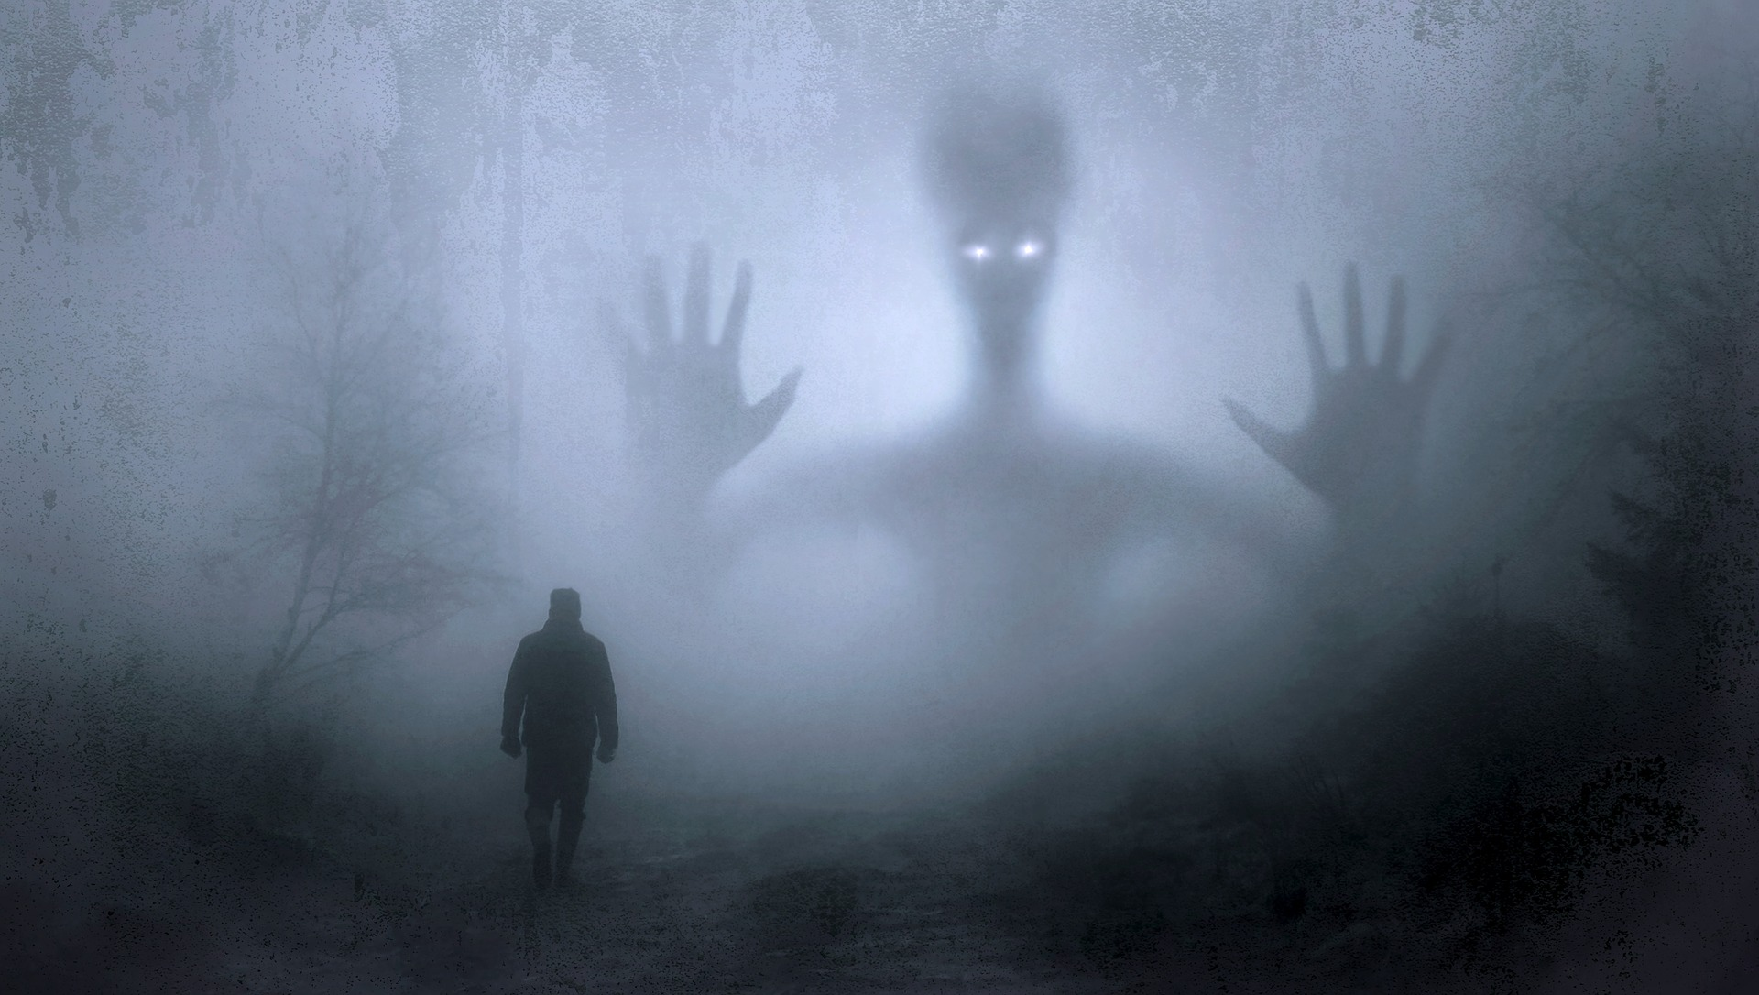

Slide 3
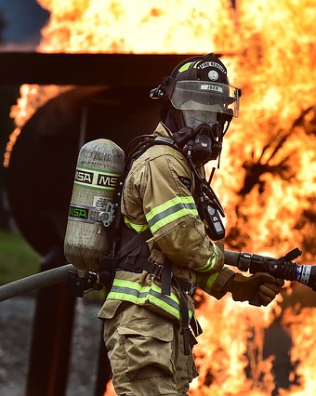
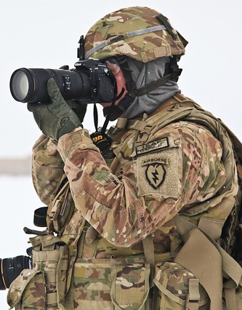

Slide 4
Two Kinds of Fear
Rational
Notes:
Some fears are merely pebbles in your shoe. They cause you a bit of anxiety but don’t really affect your life. Bridge example.

Slide 5
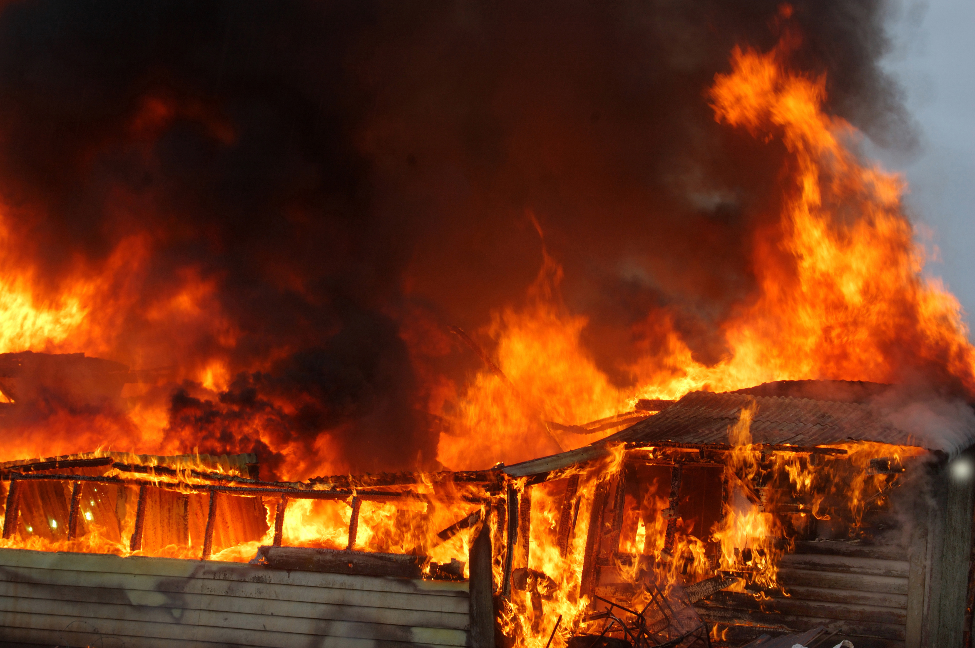

Slide 6
Two Kinds of Fear
Irrational
Notes:
Some fears are merely pebbles in your shoe. They cause you a bit of anxiety but don’t really affect your life. Bridge example.

Slide 7
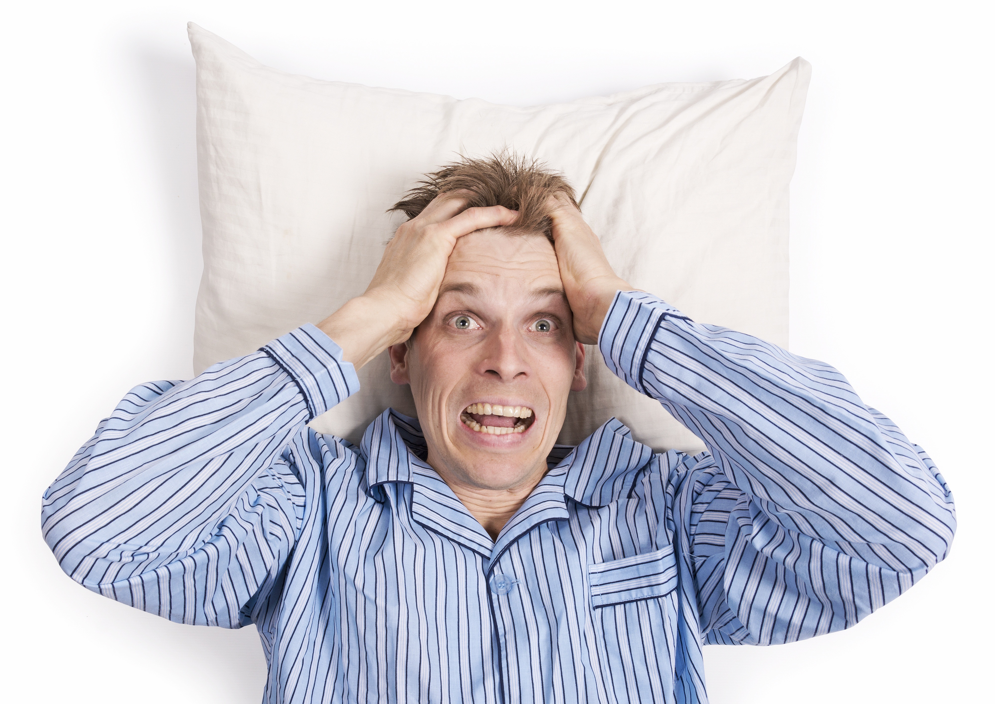

Slide 8
Two Kinds of Fear
Irrational
Not being good enough
Not being enough
Fear of what others might think or say
Need to meet other’s expectations
Feeling of not being smart enough
Being too young or too old
Disappointing others
Letting others down
Failure
Fear of not knowing what’s next
Notes:
Some fears are merely pebbles in your shoe. They cause you a bit of anxiety but don’t really affect your life. Bridge example.

Slide 9
Two Kinds of Fear
Irrational - How fear shows up
Avoidance
Procrastination
Perfection
Blame
Settling
Compromising
Rationalizing
Notes:
Some fears are merely pebbles in your shoe. They cause you a bit of anxiety but don’t really affect your life. Bridge example.

Slide 10
“
Courage is being scared to death but saddling up anyway.
John Wayne

Slide 11
3 Steps to Courage
I. Name Your Fear!
You cannot change what you
don’t acknowledge. Dr. Phil
Notes:
Tell story of my fears
At 28 I first thought about being a professional speaker. The little obstruction had become a
boulder.
Thinking I was going to die - make sure family was taken care of.
Why bother doing anything on my own. I wouldn’t be around to enjoy it.
Stayed on the detour to nowhere - See great things on the detour - wife, kids etc.

Slide 12
3 Steps to Courage
II. Frame Your Fear!
Begin to “see” your fear differently
Notes:
Tell story of my fears
At 28 I first thought about being a professional speaker. The little obstruction had become a
boulder.
Thinking I was going to die - make sure family was taken care of.
Why bother doing anything on my own. I wouldn’t be around to enjoy it.
Stayed on the detour to nowhere - See great things on the detour - wife, kids etc.

Slide 13
The way we SEE things (our beliefs about situations, other people or ourselves) affects how we FEEL.
How we FEEL affects what we DO (our behavior or actions).
What we DO affects what we GET (results).
What we GET tends to reinforce how we SEE or how we believe.

Slide 14
FEAR
Notes:
How do we see our fear - whatever it is.

Slide 15
SELFISH
Notes:
How do I see myself as a potential professional speaker.
Is it something I am afraid to pursue or is it something that if I don’t do I will be denying people the opportunity to learn from my failures.
Steve Larson story
My fear of being a speaker
Belief that God gives us each gifts and talents.
Suz Grimes - You have everything you need right now to do what you want to do. By not doing it you are denying God the joy of what He created you for.
The gifts that God gives us are not for our benefit but for the benefit of others.

Slide 16
“they’ll get rid of us all”
Notes:
How do I see myself as a potential professional speaker.
Is it something I am afraid to pursue or is it something that if I don’t do I will be denying people the opportunity to learn from my failures.
Steve Larson story
My fear of being a speaker
Belief that God gives us each gifts and talents.
Suz Grimes - You have everything you need right now to do what you want to do. By not doing it you are denying God the joy of what He created you for.
The gifts that God gives us are not for our benefit but for the benefit of others.

Slide 17
Who pays the price for your fear?™

Slide 18
3 Steps to Courage
III. Claim Your Courage!
Notes:
Tell story of my fears
At 28 I first thought about being a professional speaker. The little obstruction had become a
boulder.
Thinking I was going to die - make sure family was taken care of.
Why bother doing anything on my own. I wouldn’t be around to enjoy it.
Stayed on the detour to nowhere - See great things on the detour - wife, kids etc.

Slide 19
III. Claim Your Courage!
The word “Maybe.”
Notes:
Maybe a stalk of corn can’t grow in the middle of a busy road, but, maybe it can.
Maybe Dave can’t be a professional speaker, but, maybe he can.
Take 5 minutes and begin to process one of your fears. How can you begin to see it differently?
Maybe you can’t get your dream job, but, maybe, you can.
Maybe you can’t move your boulder, but, maybe you can.

Slide 20
III. Claim Your Courage!
Courage is an ACTION word!
Notes:
Maybe a stalk of corn can’t grow in the middle of a busy road, but, maybe it can.
Maybe Dave can’t be a professional speaker, but, maybe he can.
Take 5 minutes and begin to process one of your fears. How can you begin to see it differently?
Maybe you can’t get your dream job, but, maybe, you can.
Maybe you can’t move your boulder, but, maybe you can.

Slide 21
“
Fear calls us to be
spectators. Courage calls
us to get in the game.
Dave Cornell
Notes:
Recognize the value of a CRISIS
10th grade basketball story.
Coach saw something I didn’t see in myself.
If coach had asked me to get in the game I would have said I wasn’t ready. If you are passionate about something you are probably more ready for it than you think you are. GET IN THE GAME.

Slide 22
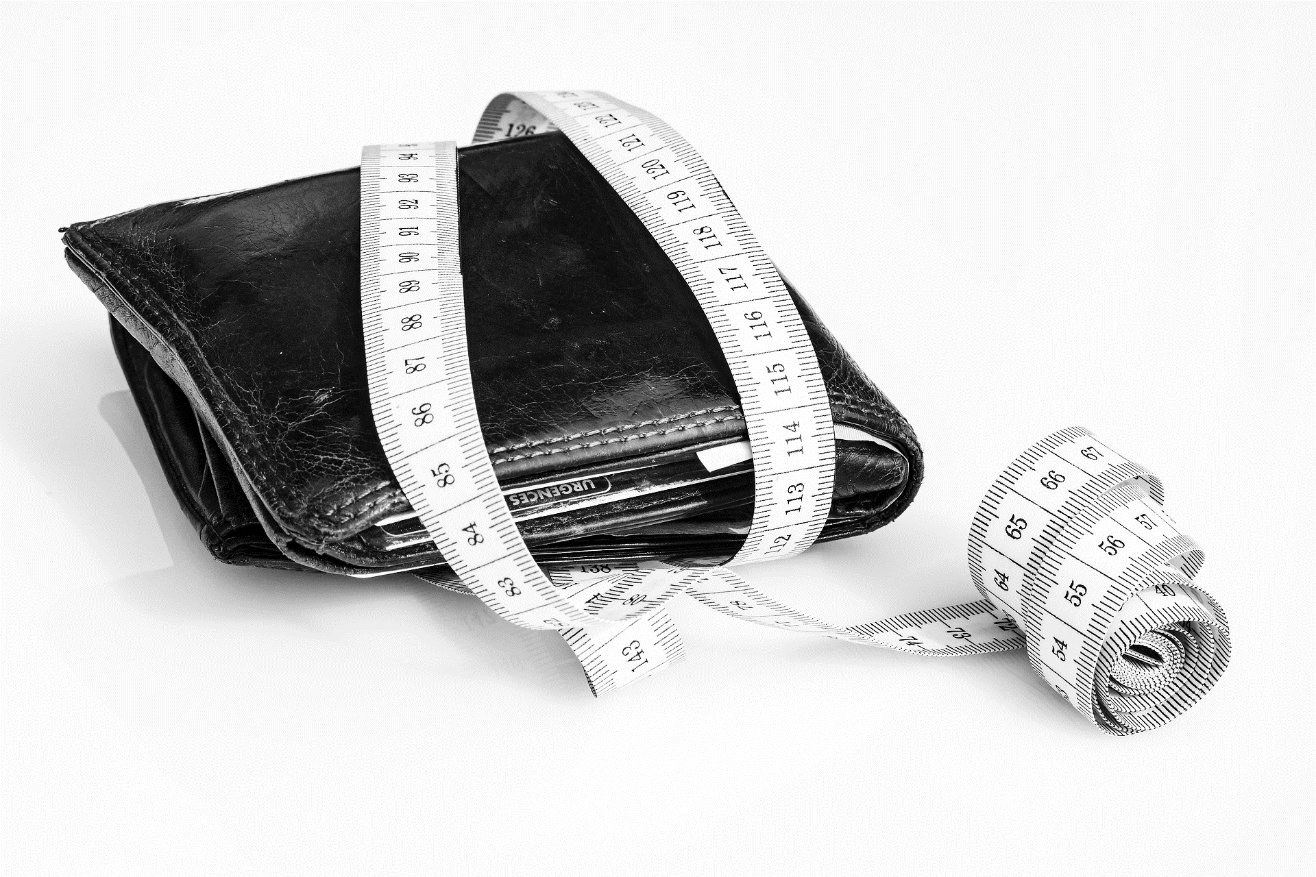
What is a lack of courage costing your team?

Slide 23
“
Organizations don’t become courageous, people do.

Slide 24
CLARITY
COMPASSION
CHARACTER
COMPETENCY
COMMITMENT
CONNECTION
CONTRIBUTION
CONSISTENCY
PILLARS of
TRUST

Slide 25
People put faith in those who care beyond themselves.
Do the work.

Slide 26
“
Everything of value is built on trust.
www.TrustEdge.com

