Slide 1
YOUR NAME HERE
CLIENT LOGO HERE
YOUR CREDENTIALS HERE
PRESENTATION DATE HERE

Slide 2
#1 question
everyone is asking
about you…..

Slide 3
“
Everything of value is built on trust.

Slide 4
[Trust Fall]
Notes:
Opener—trust fall. Vid Length :37

Slide 5
Trust is…

Slide 6
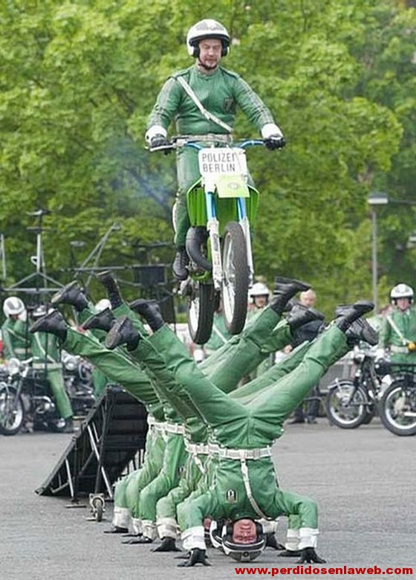
Trust is…

Slide 7
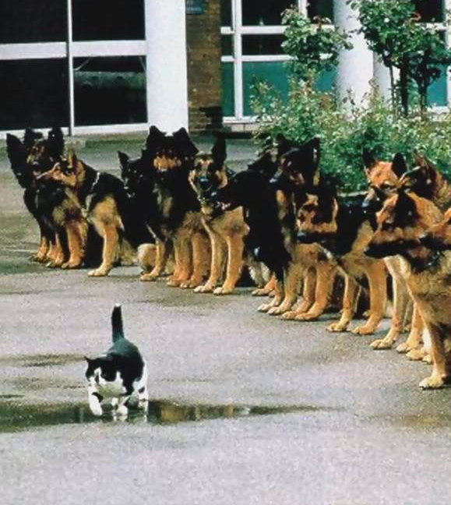
Trust is…

Slide 8
Trust is…

Slide 9
Trust is…
a confident belief in
a person, product,
or organization

Slide 10
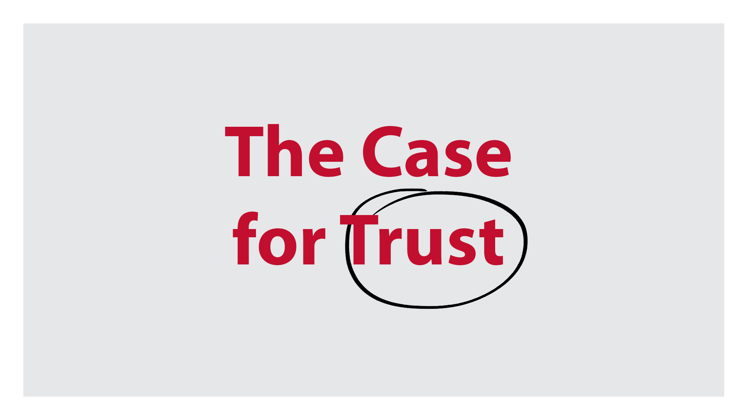

Slide 11
Revenue
Loyalty
Innovation
Productivity
Retention
Morale
Output
As trust increases…
Costs
Problems
Suspicion
Attrition
Time to
market
Stress

Slide 12
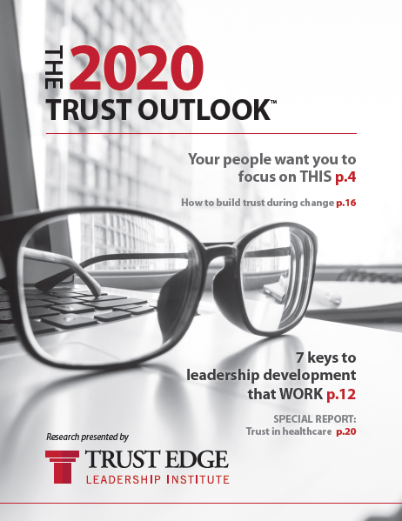
The Trust Outlook
A look at the landscape and impact of trust across divisions and around the world.

Slide 13
#1 reason people want to work for an organization?
Trusted Leadership! -Trust Outlook®
Notes:
U.S. – (23% trusted leadership, 19% benefits, 19% higher compensation, 16% personal development opportunities, 15% fun environments)

Slide 14
9 out of 10 Americans would not refer the products or services of an organization they don’t trust.
-Trust Outlook®
The 2019 Trust Outlook™
Notes:
Yes 76%
No 24%
Photo source: https://estour.com.ua/wp-content/uploads/2016/07/img_8331.jpg

Slide 15
Half of all would work longer hours… be a better team player… be more loyal… IF they trusted senior leadership more.
-Trust Outlook®
PEOPLE
GEN Y
GEN Z
TRADITIONALISTS
GEN X
BOOMERS

Slide 16
48% of all Americans have invested $1,000
or more based purely on trust.
-Trust Outlook®

Slide 17
More than 13 million Americans invested
over $100,000
based purely on trust.
-Trust Outlook®
$
$
$
$
$
$
$
$
$
$
$
$
$
$
$
$
$
$
$
$
$
$
$
$
$
$
$
$
$
$
$
$
$
$
$
$
$
$
$

Slide 18
#1 way to influence people changing opinions?
Trusted Relationships! -Trust Outlook®
10% Social Media
26% News Source
64% Trusted Relationship
Notes:
2022 T.O.

Slide 19
92%
Only 13% of people completely TRUST their current employer. -Trust Outlook®

Slide 20
A lack of trust is your BIGGEST expense.

Slide 21
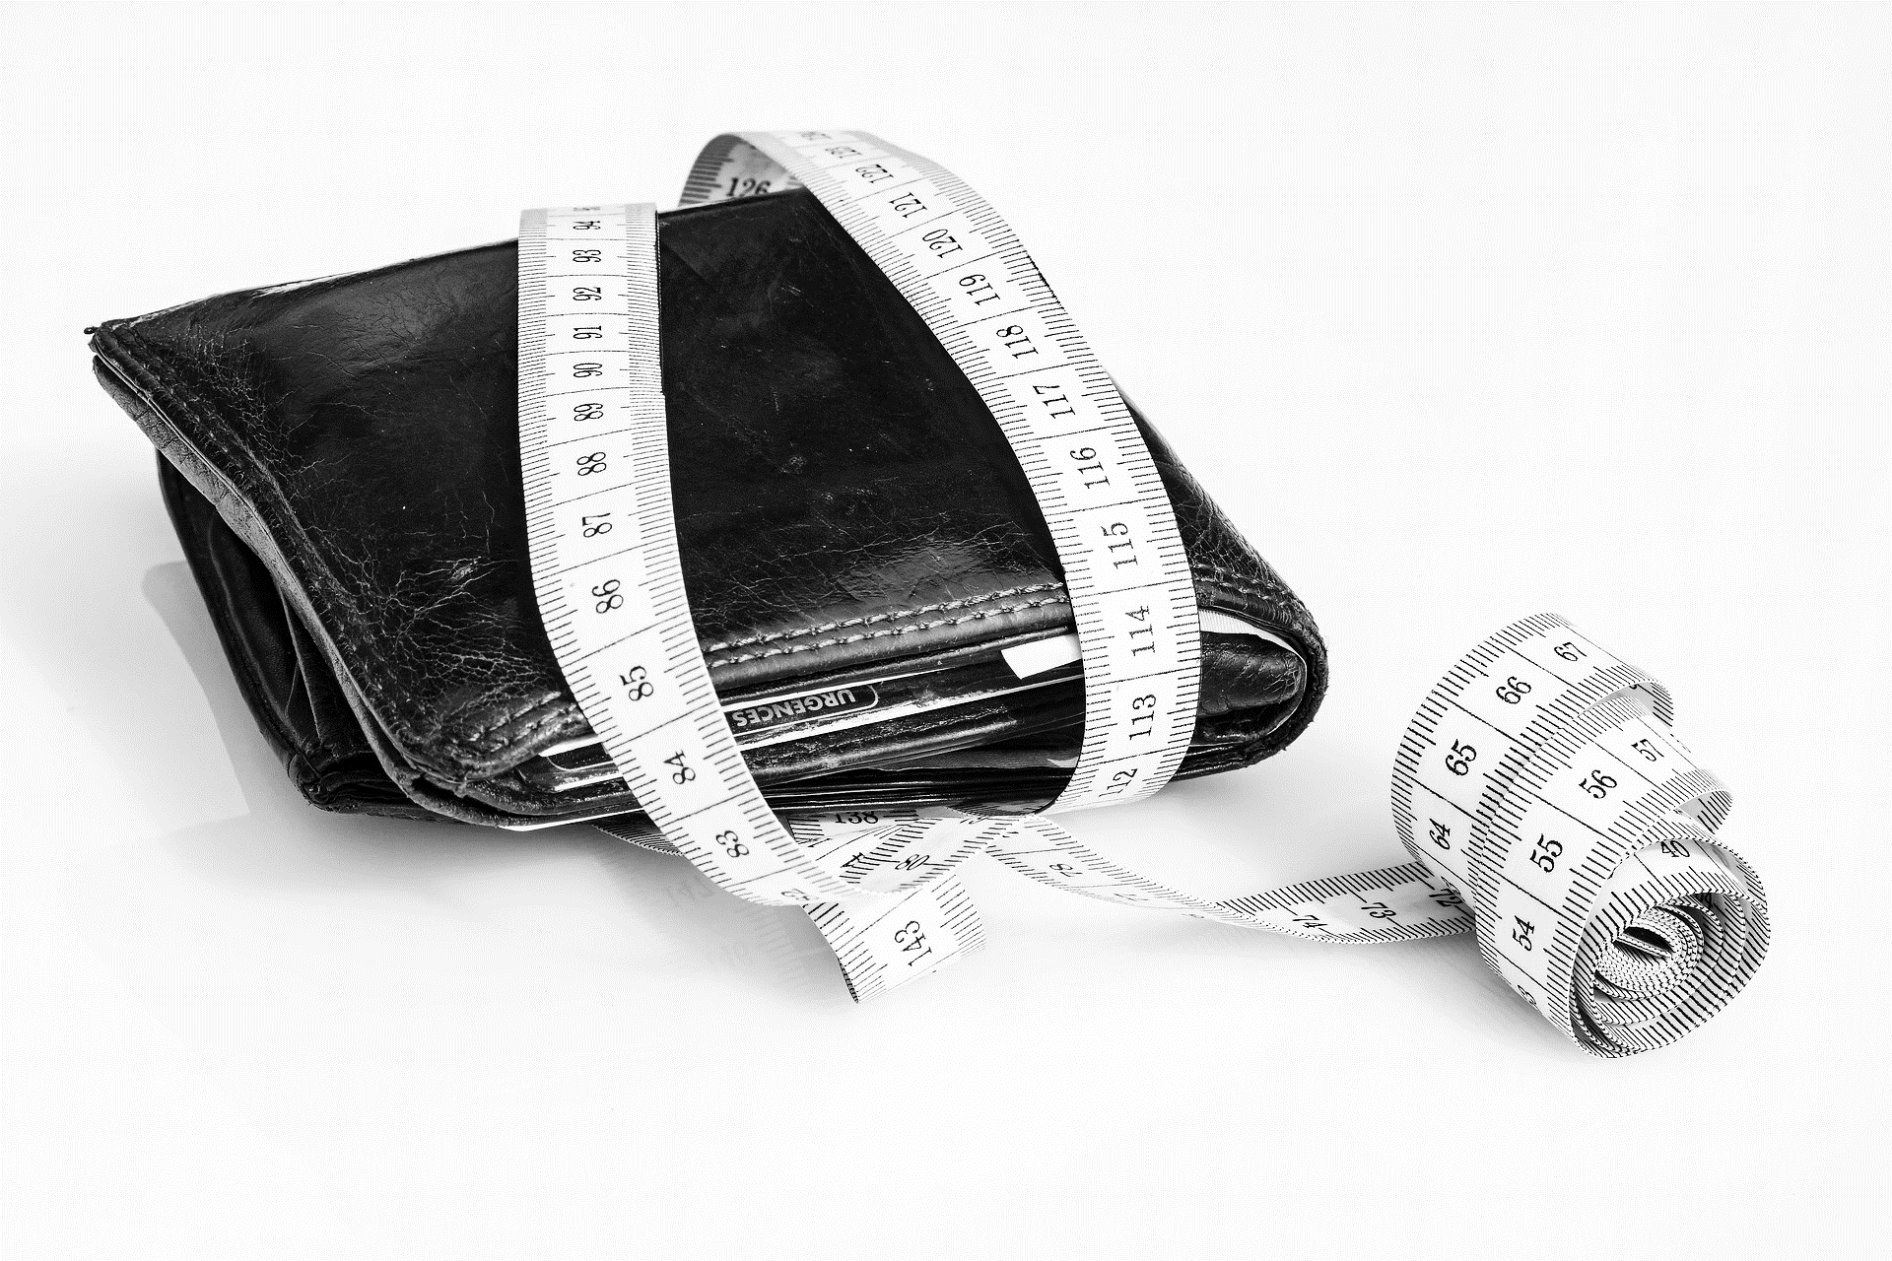
What is a lack of trust costing your team?

Slide 22
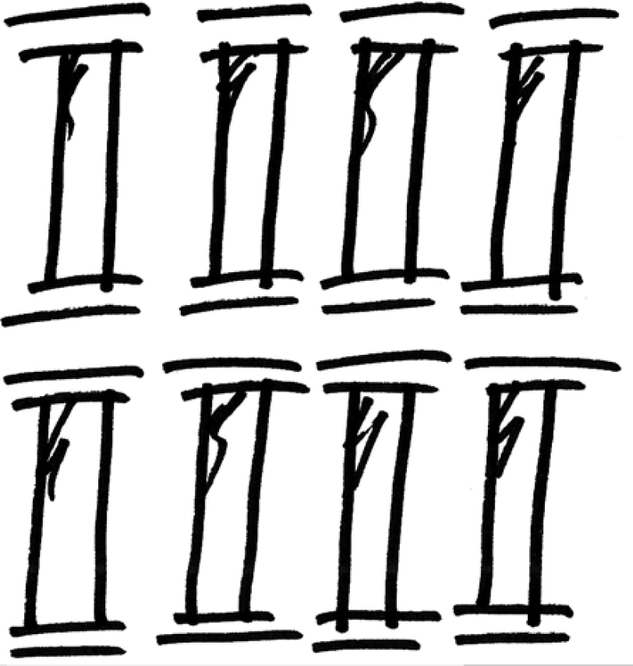
1
2
3
4
5
6
7
8
CLARITY
COMPASSION
CHARACTER
COMPETENCY
COMMITMENT
CONNECTION
CONTRIBUTION
CONSISTENCY
PILLARS of
TRUST

Slide 23
CLARITY

Slide 24
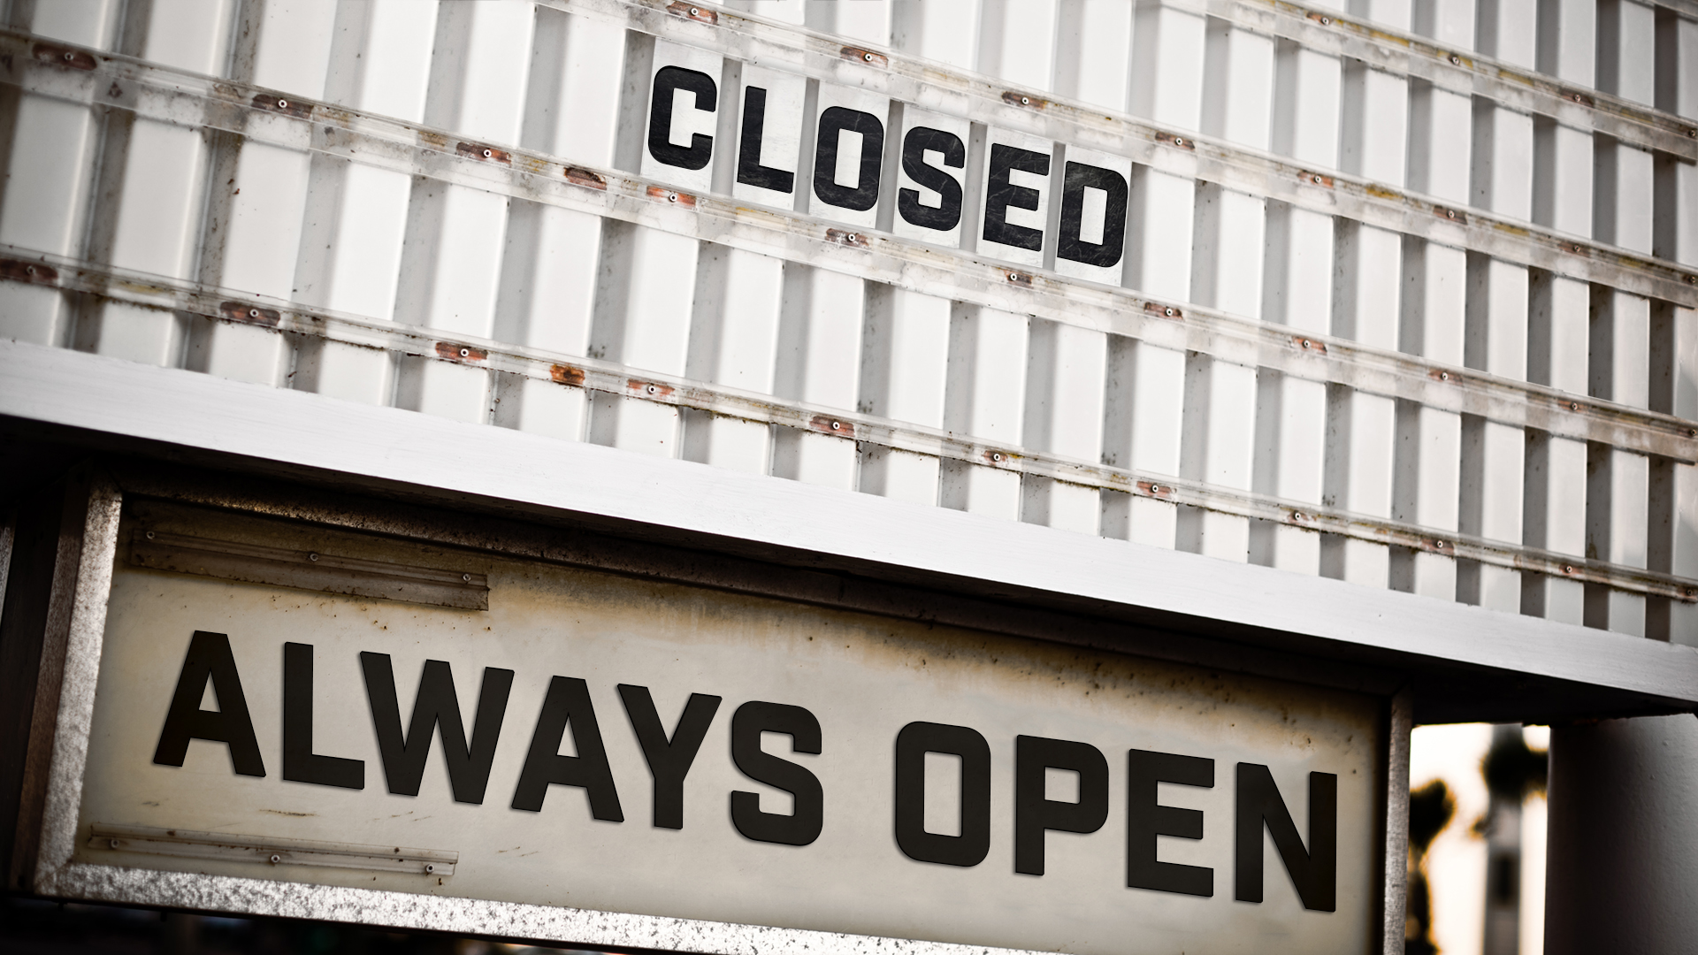

Slide 25
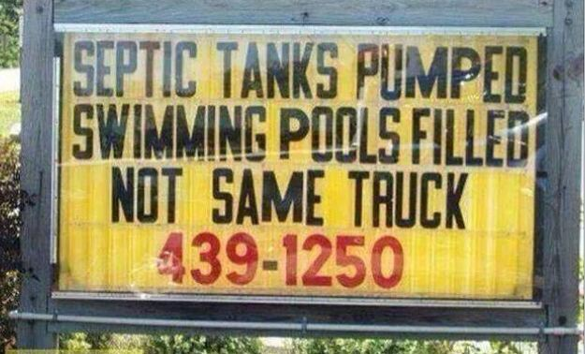

Slide 26
People trust the clear, but distrust the ambiguous.

Slide 27
95% of all workers are unaware of their company’s top objectives.
-HP Insider Series

Slide 28
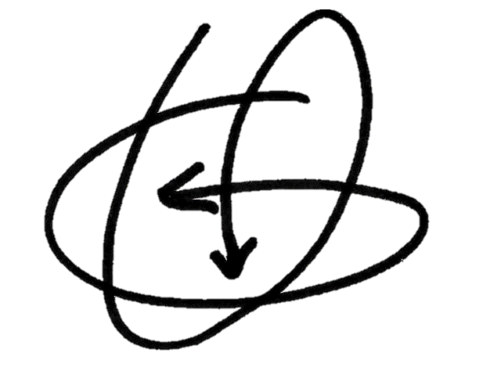
VUCA (U.S. Army)
What can I control?
What should I do first?

Slide 29
90-Day Quick Plan
Where am I right now?
Where do I want to be in 90 days?
Why am I going?
HOW am I going to get there?
HOW am I going to get there?
HOW am I going to get there?

Slide 30
3 QUESTIONS TO CLARITY
1. HOW?
2. HOW?
3. HOW?

Slide 31
Clarity unifies and MOTIVATES.

Slide 32
COMPASSION

Slide 33
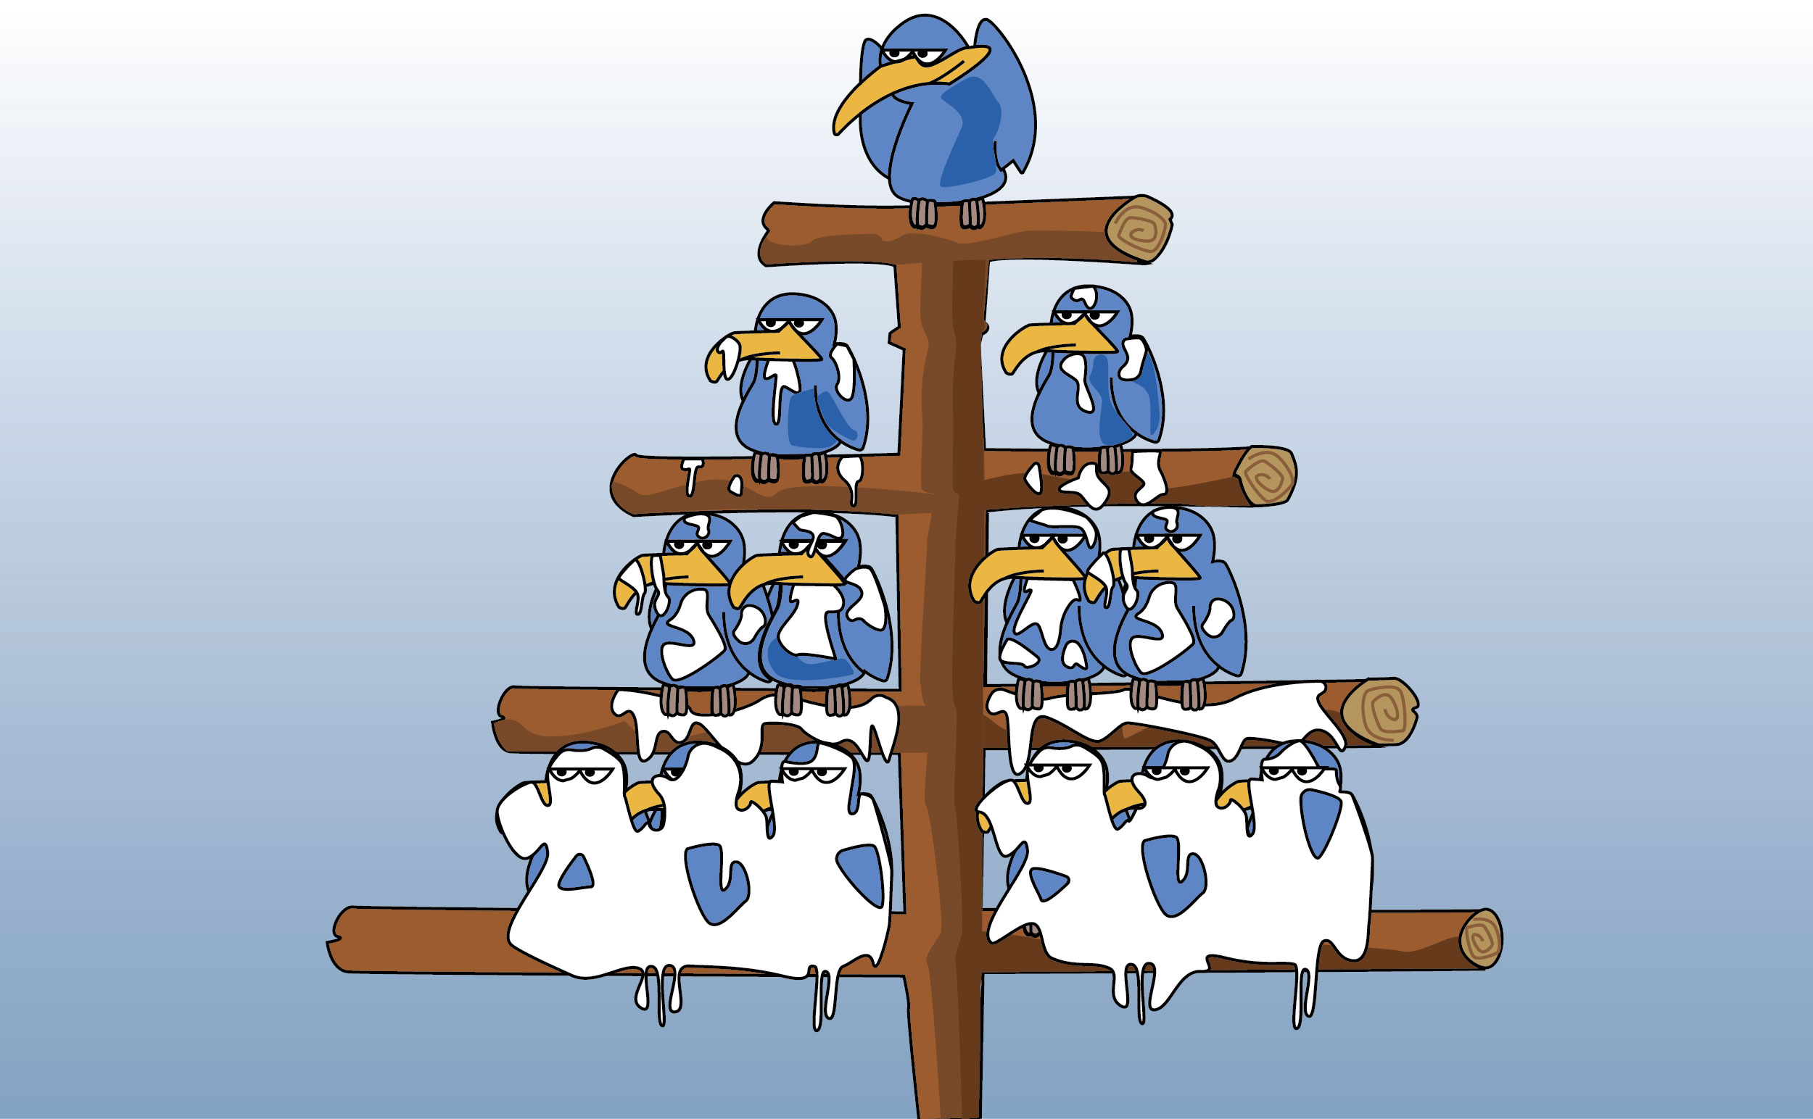

Slide 34
People put faith
in those who care beyond themselves.
People put faith in those who care beyond themselves.

Slide 35
Listen
Appreciate
Wake Up & Be Present
Serve Selflessly

Slide 36
#1 reason people leave an organization? Not feeling appreciated.
-Trust Outlook®
Notes:
(Global: 33% you do not feel appreciated, U.S. 36% you do not feel appreciated)
Other options (global): you are not aligned with the values 21%, you do not feel capable in your role 11%, you do not trust the leadership 26%, your co-workers are annoying 8%
Photo by Clem Onojeghuo from Pexels https://www.pexels.com/photo/administration-adult-architecture-building-375886/

Slide 37
SPA Method
Meaningful appreciation is:
Specific
Personal
Authentic

Slide 38
“
Think beyond yourself.

Slide 39
CHARACTER

Slide 40
“
People notice those who do what is right over what is easy.

Slide 41
“
Do what needs to be done, when it needs to be done, whether you feel like it or not.

Slide 42
3 QUESTIONS FOR CHARACTER

Slide 43
Would you follow you?

Slide 44
Do you have decision-making values?

Slide 45
Decision-Making Values
________________________________________________________
________________________________________________________
________________________________________________________
________________________________________________________
________________________________________________________
Notes:
http://www.youtube.com/watch?v=oL7E7hsmOJU&list=TLcfXJFTiDwX8

Slide 46
Do you incentivize against the character you want to see?

Slide 47
Humility is the first step to ability.

Slide 48
COMPETENCY

Slide 49
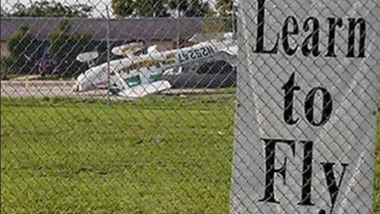

Slide 51
HOW am I staying
FRESH, relevant and
CAPABLE?

Slide 52
Knowledge is 5X more valuable than positive ratings for a salesperson.
-Trust Outlook®
Trust Outlook®
Notes:
Answering questions 18%, Being knowledgeable about the product 38%, Explaining all costs clearly 19%, Listening actively 18%, Sharing positive ratings 7%

Slide 53
76% of all employees believe that ongoing training would help them trust their employer more.
-Trust Outlook®
Notes:
Yes 76%
No 24%
Photo source: https://estour.com.ua/wp-content/uploads/2016/07/img_8331.jpg

Slide 54
Input = Output
Improve Input

Slide 55
Improve Input
Reading
Podcasts
Feedback
Book club
Advice
Mentoring
In-house training
Continuing education
Mastermind groups
Industry associations
Formal education
Community classes
Coaching
Online classes
Conferences
Improve Input

Slide 56
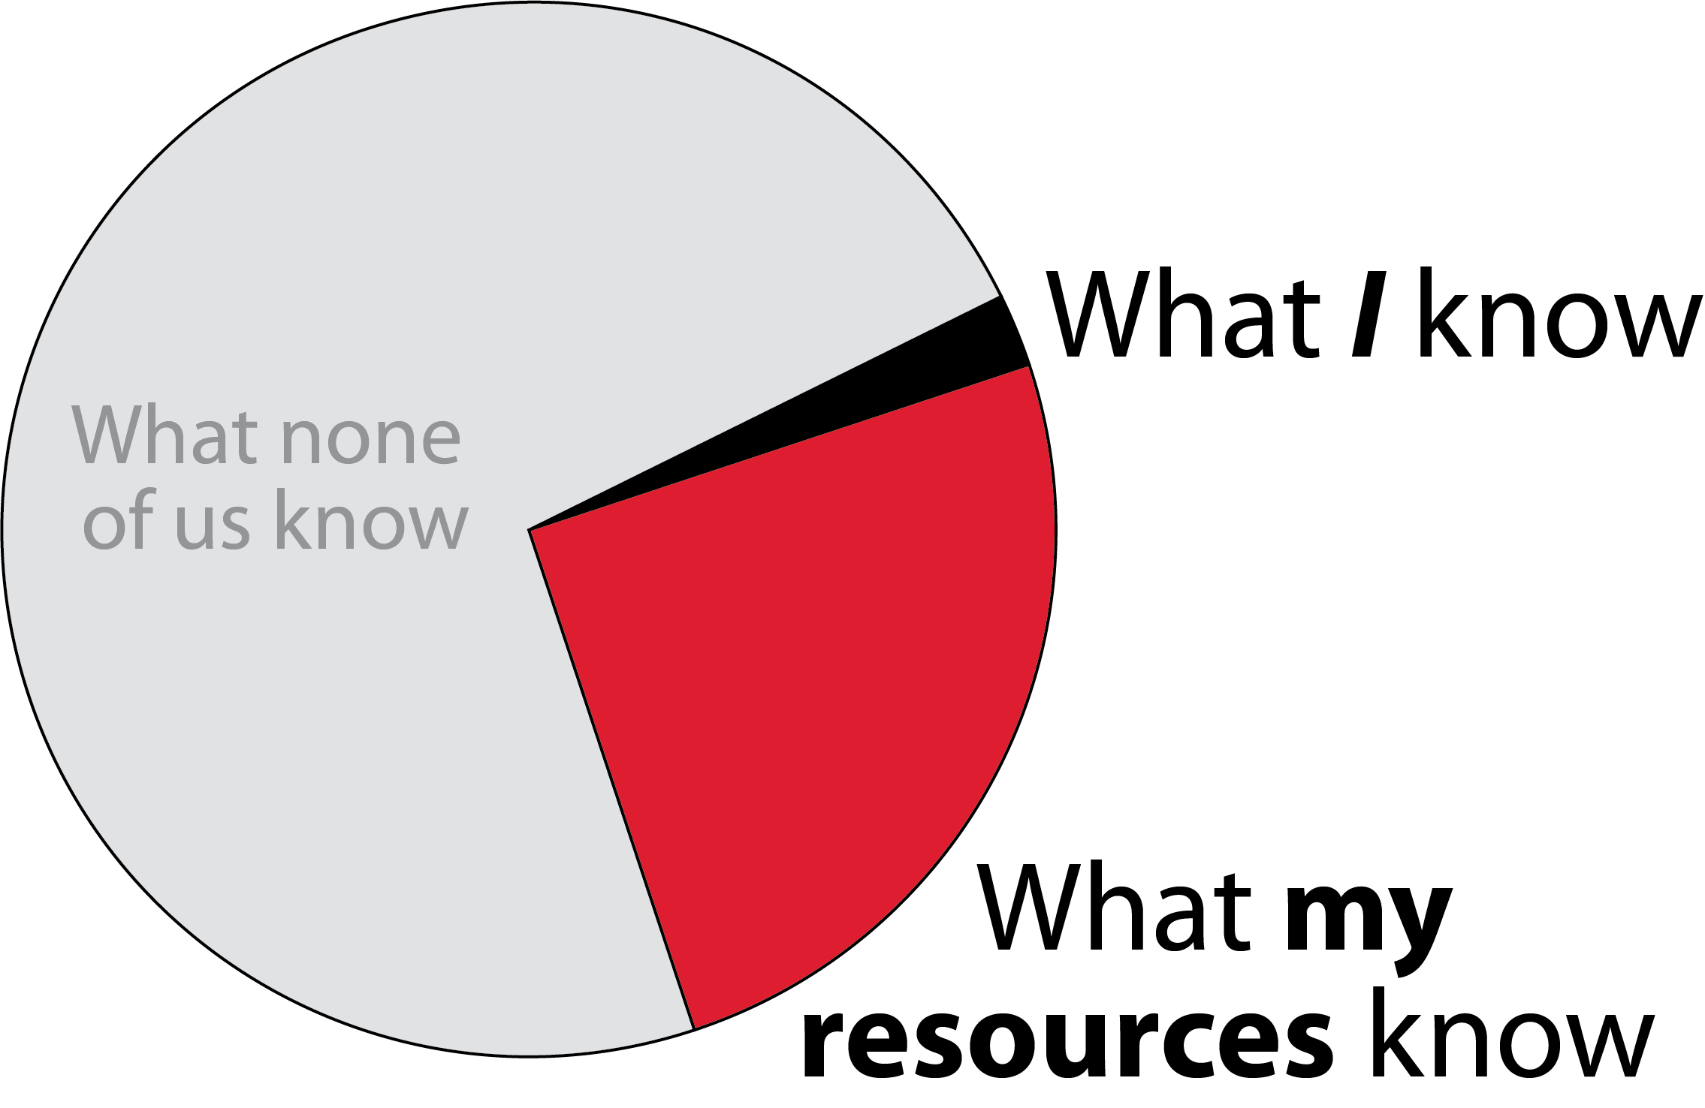
Solving an Issue
What none of us know

Slide 57
We must be increasingly competent in the areas where we want to be trusted.

Slide 58
COMMITMENT

Slide 59
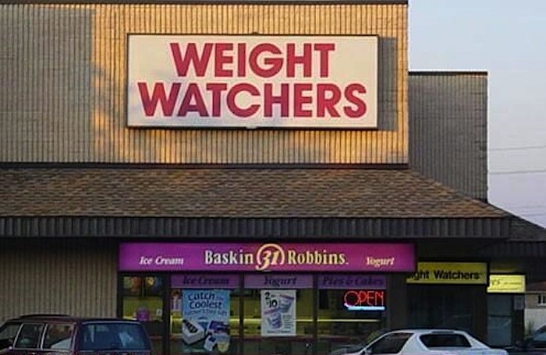

Slide 60
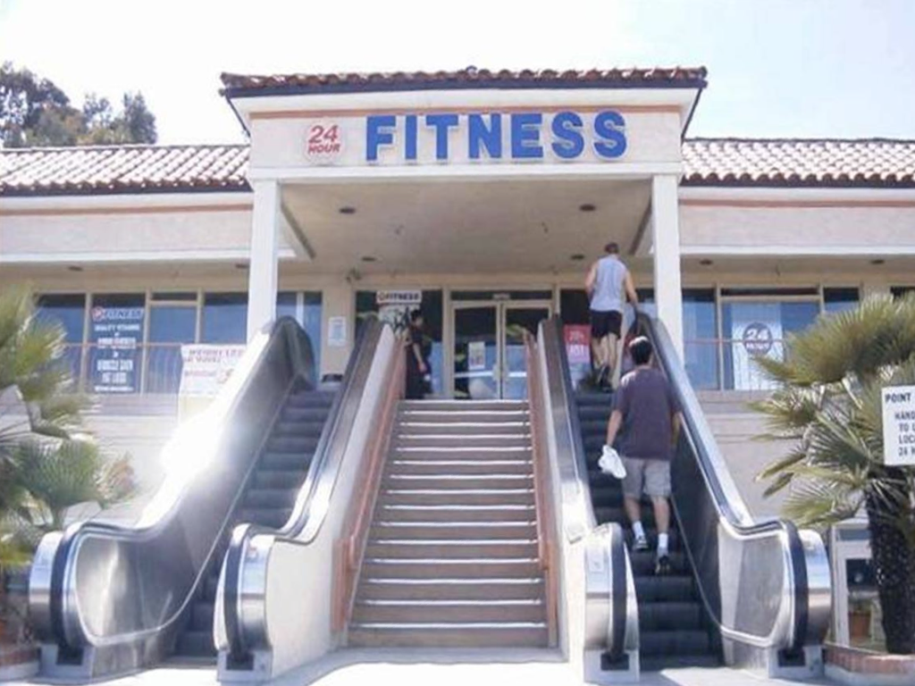

Slide 61
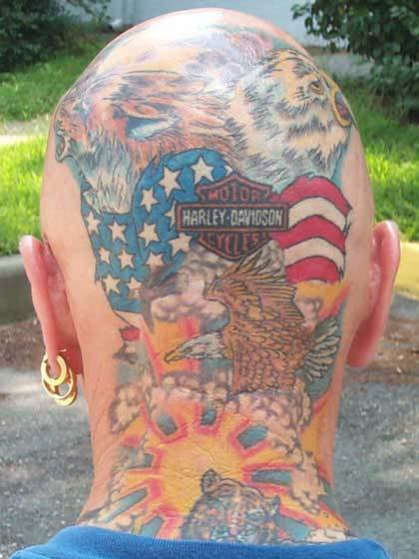

Slide 62
People believe in those who stand through adversity.

Slide 63
#1 action that would increase retention:
Keep promises.
-Trust Outlook®
Notes:
64% either transparency or keeping promises (35% transparency is practiced, 29% promises are kept)

Slide 64
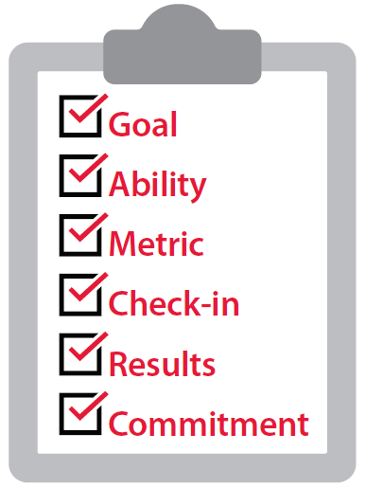
Create Accountable Culture
Clear Goal
Clear Ability
Clear Metric
Clear Check-in
Clear Results
Clear Commitment

Slide 65
The fastest way to rebuild trust is to make and keep a commitment.

Slide 66
CONNECTION

Slide 67
“
People trust those who are willing to connect
and collaborate.

Slide 68
The #1 motivation for persevering on a project is collaboration.
-Trust Outlook®
Notes:
U.S. –
Collaboration – 31%
Unified Objective – 30%
Anticipation of Reward - 21%
Fear of Failure – 18%

Slide 69
What is the #1 trait of the most magnetic people
in the world?

Slide 70
Ways to Connect
Storytelling
Collaborative thinking
Transparency
Vulnerability
Curious questions

Slide 71
“
Nothing great has ever been achieved alone.

Slide 72
CONTRIBUTION

Slide 73
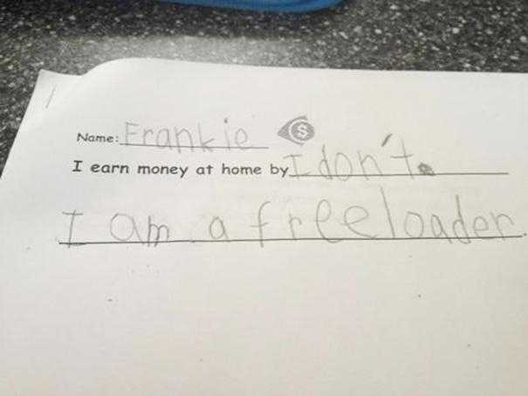

Slide 74
“
People immediately
respond to results.

Slide 75
6E’s Model
Example
Expectation
Education
Encouragement
Empowerment
Extending Trust

Slide 76
“
“Doing”, not “saying”, builds trust.
Notes:
Opener—trust fall

Slide 77
CONSISTENCY

Slide 78
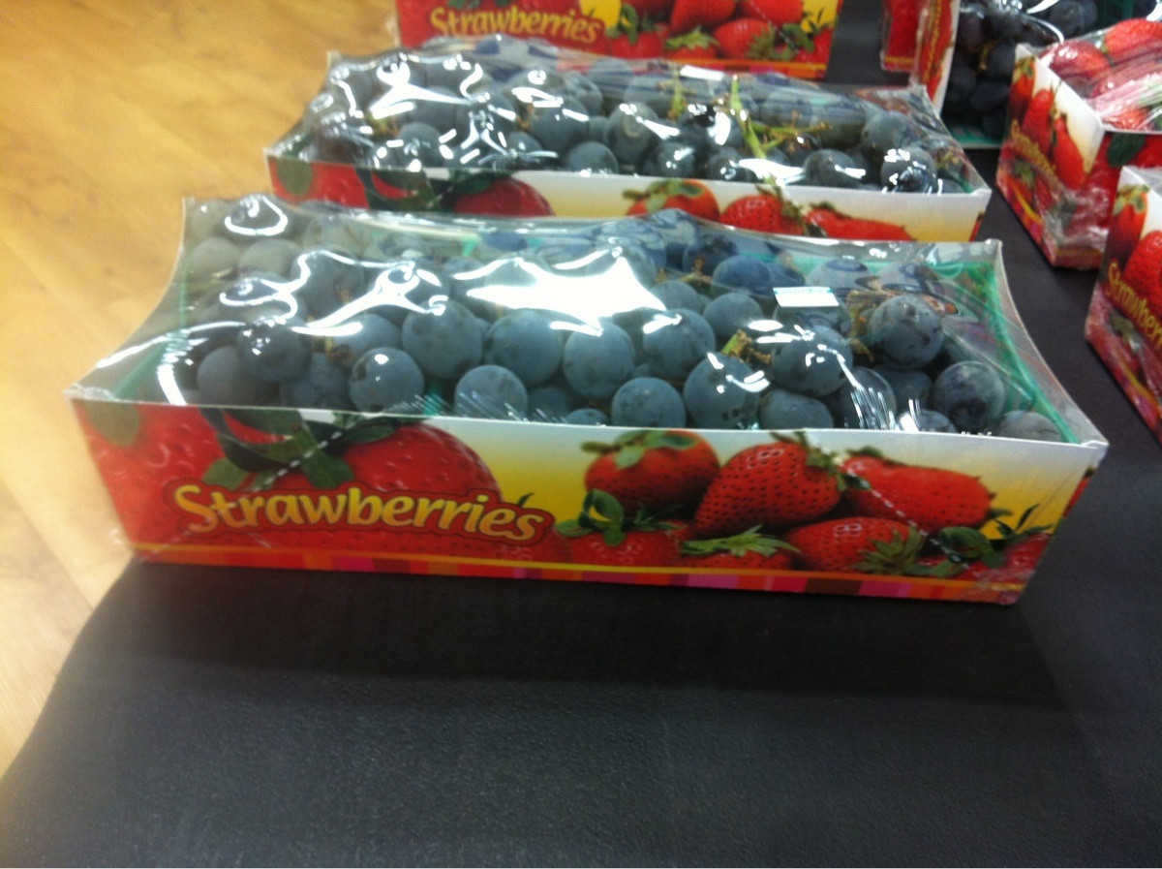

Slide 79
“
It is the little things, done consistently, that make the biggest difference.

Slide 80
In every interaction we either increase or decrease trust.
People put faith in those who care beyond themselves.

Slide 81
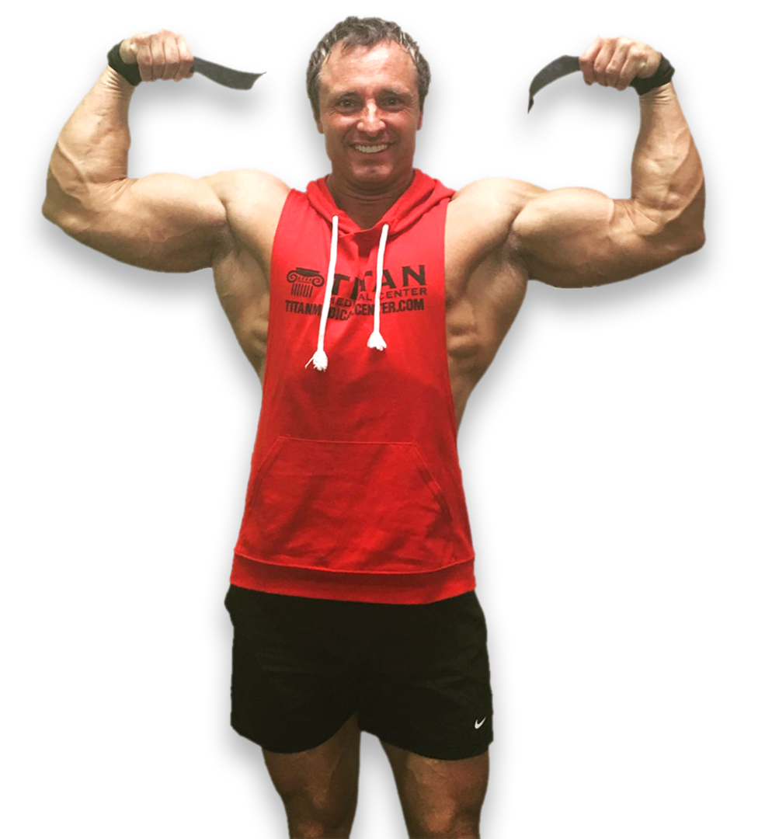
Atrophy is GUARANTEED
without intentional ACTION
206 lbs.
140 lbs.

Slide 82
Healthy Things GROW

Slide 83
“
One inconsistency can change people’s perspective.
Notes:
Opener—trust fall

Slide 84
“
Organizations don’t change
people do.

Slide 85
CLARITY
COMPASSION
CHARACTER
COMPETENCY
COMMITMENT
CONNECTION
CONTRIBUTION
CONSISTENCY
PILLARS of
TRUST

Slide 86
People put faith in those who care beyond themselves.
Do the work.

Slide 87
“
Everything of value is built on trust.
www.TrustEdge.com

