Slide 1
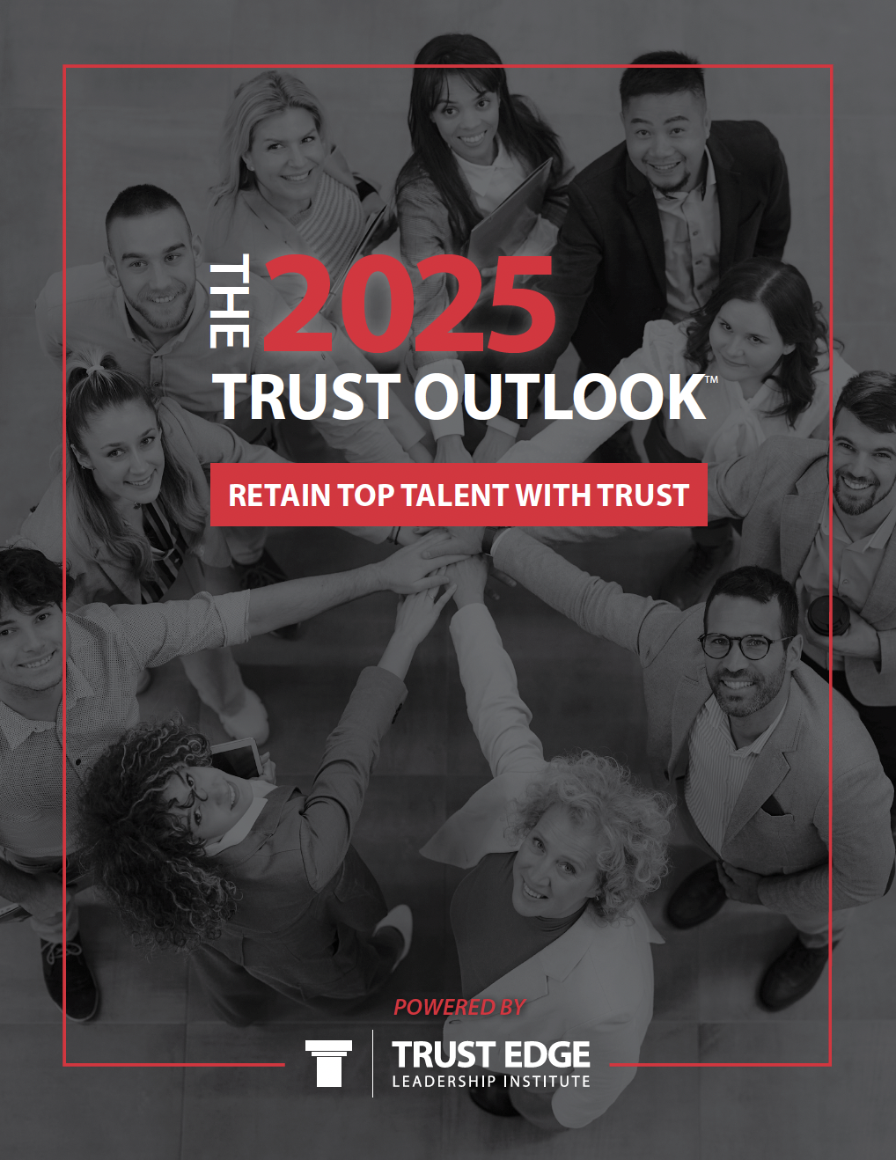
The 2025
Trust Outlook®️
Notes:
Our process:
Question ideation – what are we curious about? What do we think our clients will be curious about? What will Certified Partners be curious about?
Answer: Working America
- Survey out in the world for a couple weeks, then get data back
Analyze analyze analyze
Fascinating results all over the place BUT
“WHAT’S THE STORY HERE?
So much data: Retention

Slide 2
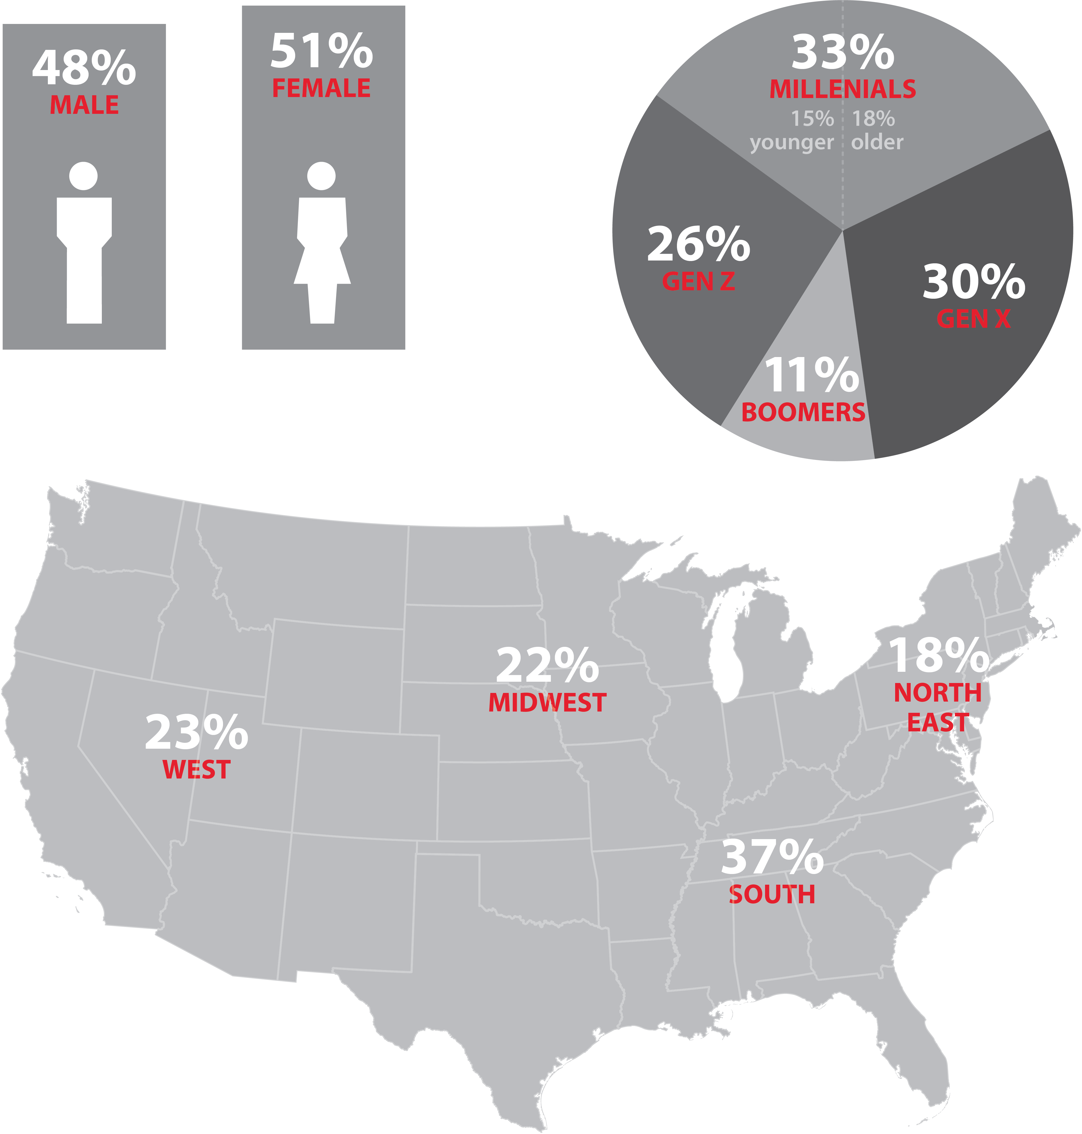

Research Participants
Actively employed individuals from across the United States
Notes:
Weighted to the 2020 U.S. Census for age, region, gender, and ethnicity.
Margin of error is +/-3.58 percentage points.

Slide 3
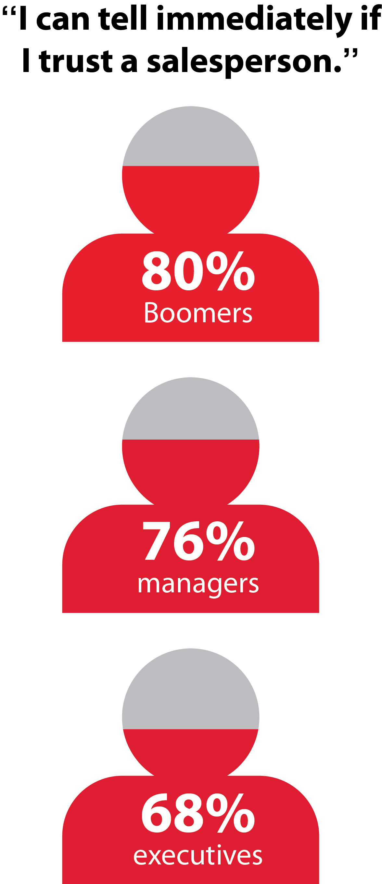
Trust in a salesperson is won or lost in seconds!
BOOMERS
MANAGERS
-Trust Outlook®
EXECUTIVES
Notes:
80% of Boomers, 76% of managers, and 68% of executives agreed
with this statement: “As a customer, I can tell whether or not I trust a salesperson right away.”
WE’RE ALL IN SALES – DAN PINK
Is being very strategic in these first moments something you are already doing or is this an opportunity for growth for you?
Whats behind such a high level of confidence?
Ending Point
Analyze and evaluate your verbal AND non-verbals in your initial interaction with prospects – you might unlock something
Key Word: Intentionality!

Slide 4
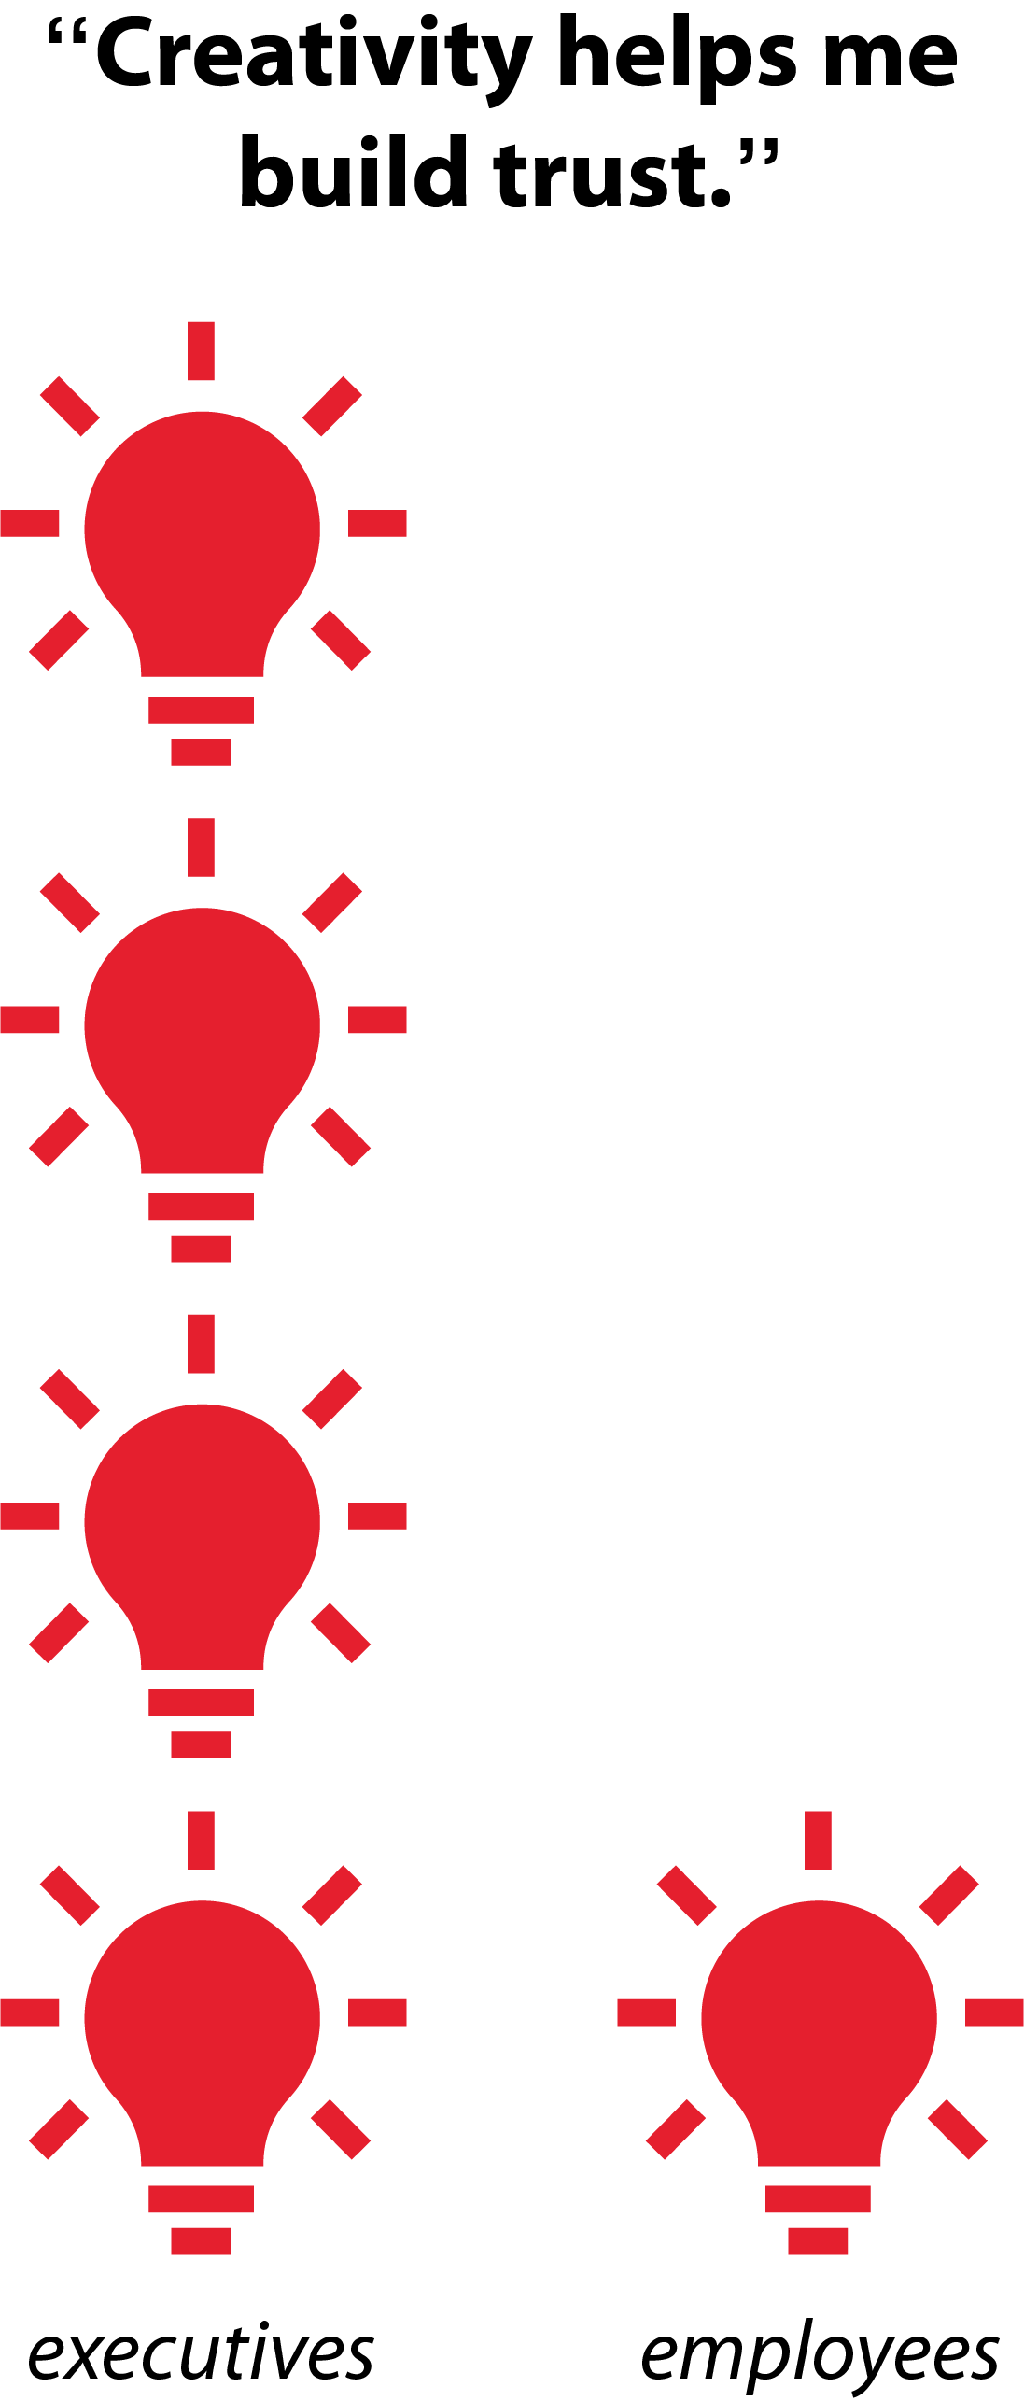
Executives are 4x more likely to believe creativity is essential for building trust.
-Trust Outlook®
Notes:
One of the “Surprise!” stats
“Being creative” was selected by executives as essential for building trust 4x as much
as it was selected by employees.
This higlights a gap – but what creates this?
Critical : how Executives RESPOND to creative opportunities.
- only takes ONE poor response to someone's attempt to share to shut that valve off - and word spreads.
Pillar Focus: Connection. Are your clients creating opportunities for genuine connection?
And in an atmosphere conducive to sharing creative concepts?
If your struggling with this – hold up a mirror?
BECAUSE…NEXT SLIDE

Slide 5
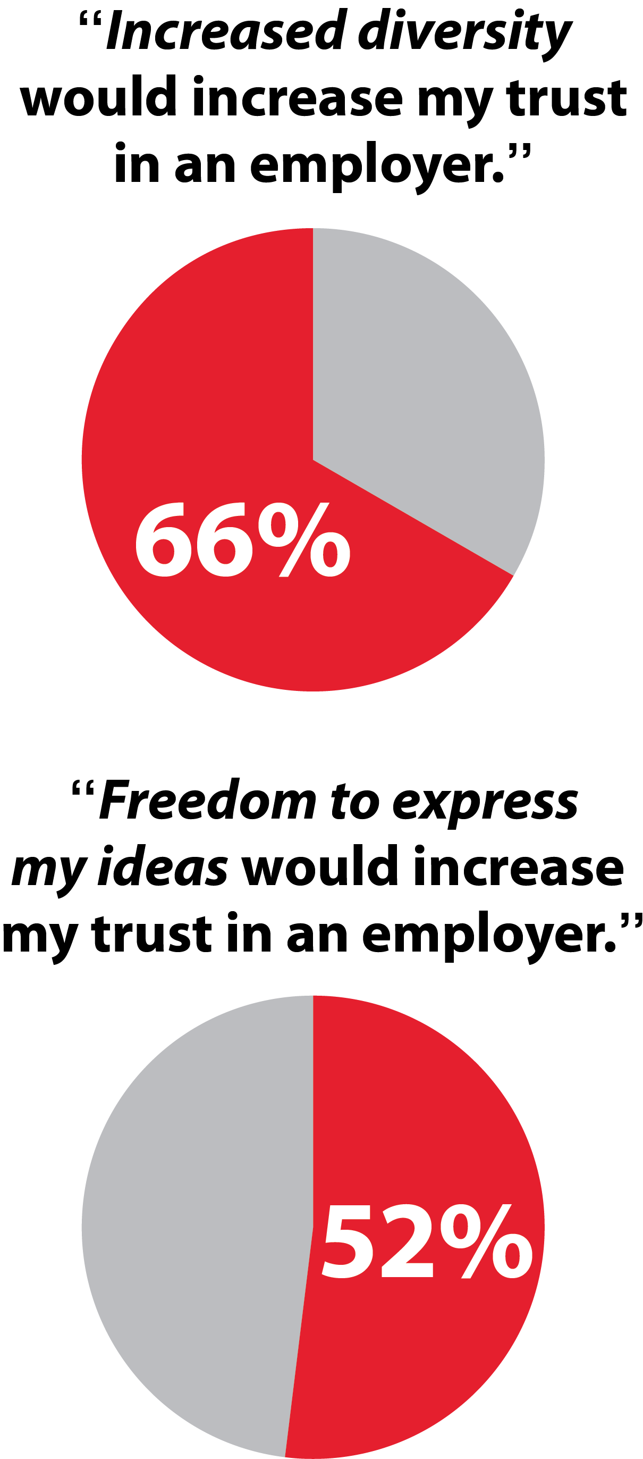
Low wage earners believe increased diversity and freedom to express ideas build trust in an employer!
Trust Outlook®
Notes:
2/3rds of low wage-earners believe increased diversity will increase trust in an employer. More than 50% of them want more freedom to express ideas.
tension with our previous stat….more than half of front line/hourly/lower wage earners recognized that the opportunity to express their ideas – AKA: share their creativity– would build Trust in their employer.
This is simple math.
Set the stage for creative dialogue, be careful and intentional in how you respond
Watch the trust grow on both sides.

Slide 6
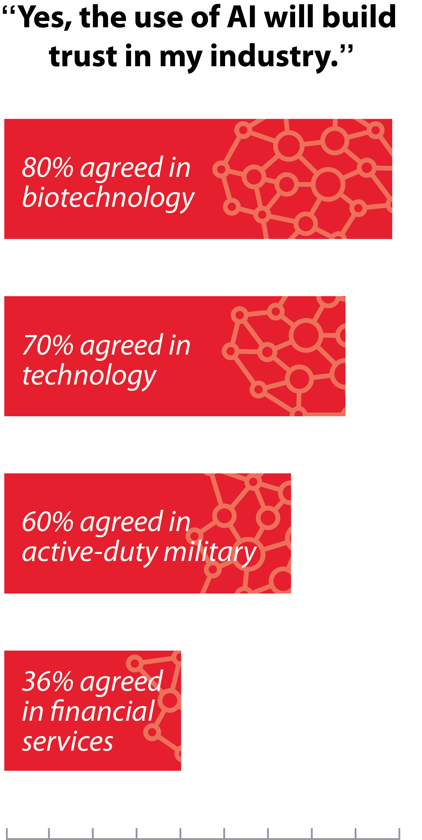
The industry you work in influences trust levels in A.I.
-Trust Outlook®
Notes:
Some fields—biotechnology, technology, and the military—rank AI highly as a trust
builder while others—like finance—believe it’s a trust killer.
QUESTION: Take a look at the fields on the screen – where does your industry fall?
COMPETENCY PILLAR: STAY FRESH AND RELEVANT. How can AI support your clients?
The takeaway here: don’t assume. Don’t assume your client is ready, willing and/or excited to embrace AI.

Slide 7
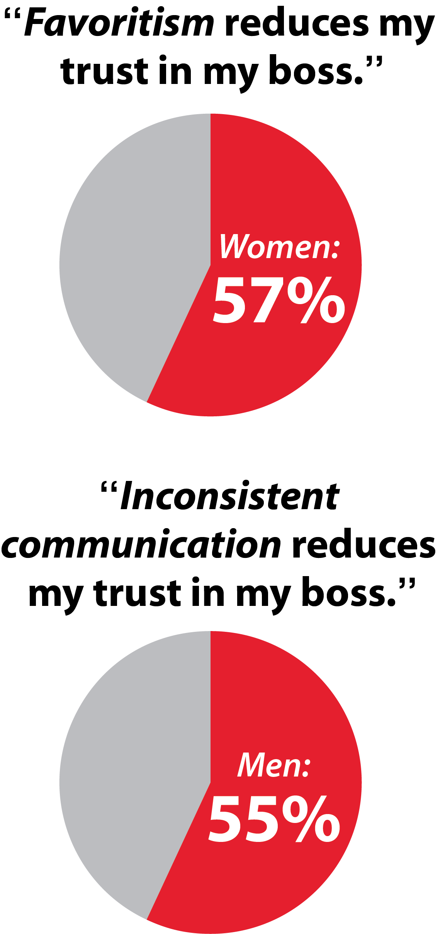
“Inconsistent communication
reduces my trust in my boss.”
Trust Outlook®
Notes:
While 57% of women ranked favoritism as one of their top three “bad boss” behaviors, 55% of men selected “inconsistent communication.”
“Biggest bang for the buck” stats. The ROI on addressing these is massive.
Both these stats can be fixed with CONSISTENCY
Consistent standards for celebration and promotions. If you’re coaching people in leadership, check in with their protocals. And if they ask why, be ready to explain this stat. You can drive higher levels of trust
Consistent communication
Meetings: especially in 1:1s
Channels [email]
Newsletters
Updates

Slide 8
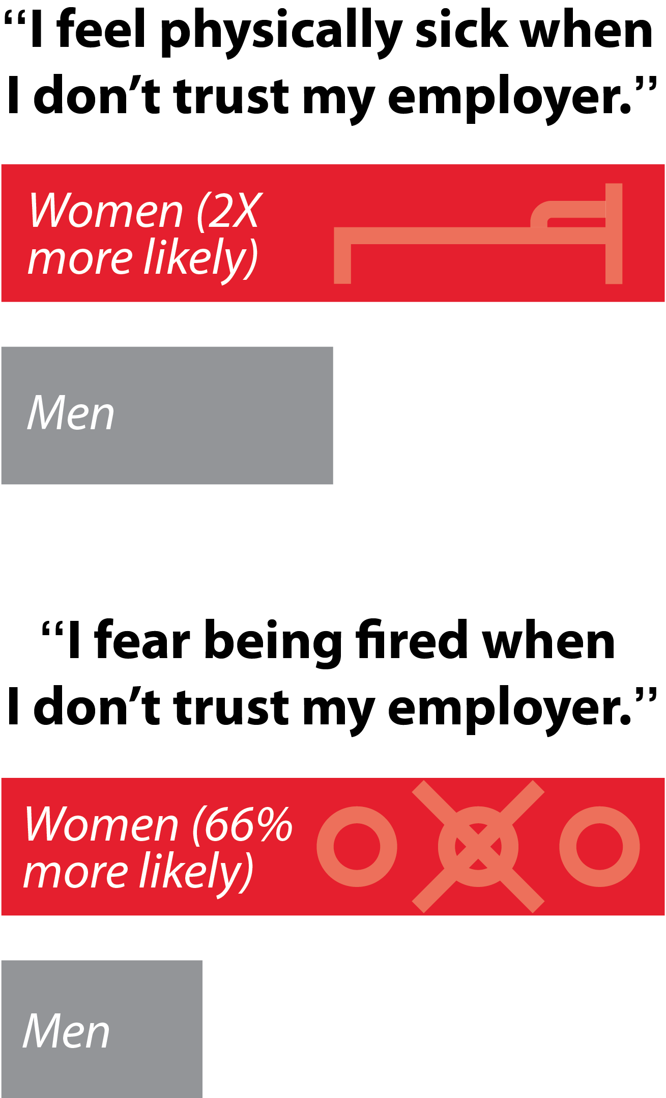
Trust Outlook®
Notes:
When they don’t trust their employer, women are two times more likely than men to feel physically sick and are 66% more likely than men to feel fearful of being fired.
The most up to date statistic we could find from the US Bureau of Labor Statistics is that the US Workforce is now 57.5% women.
Lens of Productivity and Longevity- d the cost of a lack of Trust.
These can be great stats to incorporate into your case for Trust delivery
Who performs their best when you combine a lack of trust with feeling PHYSICALLY ill
Or being fired?
Invest in trust and you’re investing in the prevention of these two crippling experiences.

Slide 9
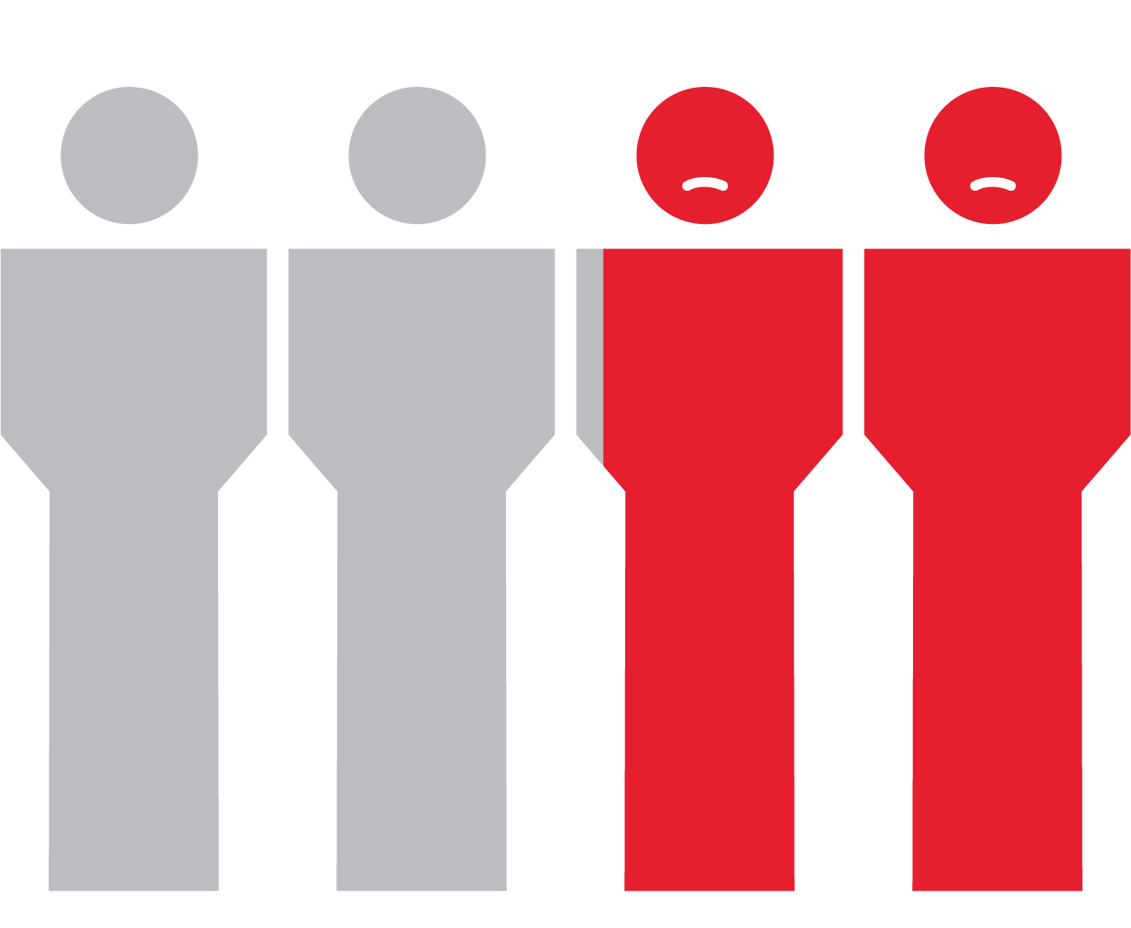
45% of people have quit a job because they could not TRUST their company’s leaders.
-Trust Outlook®
Notes:
45% of all respondents—regardless of age, gender, or company position—have quit a job because they could not trust their company’s leaders.
This is the most important stat of the research. If you’re working with a client who has churn, this stat will put a number to what they’ve felt.
I almost threw out this question. We believe it’s probably the #1 reason someone elaves a job, but Ihaven’t been convinced people could always trace it back to that being the root issue. I bet 10% of people would state this.
But almost Half of working America can pin point and acknowledge a lack of trust in their leadership as why they left.
Another critical case for trust stat. and a crticial stat to support not just working on ONE pillar, but on all 8.
People don’t quit jobs. They quit working for people they don’t trust.”

Slide 10
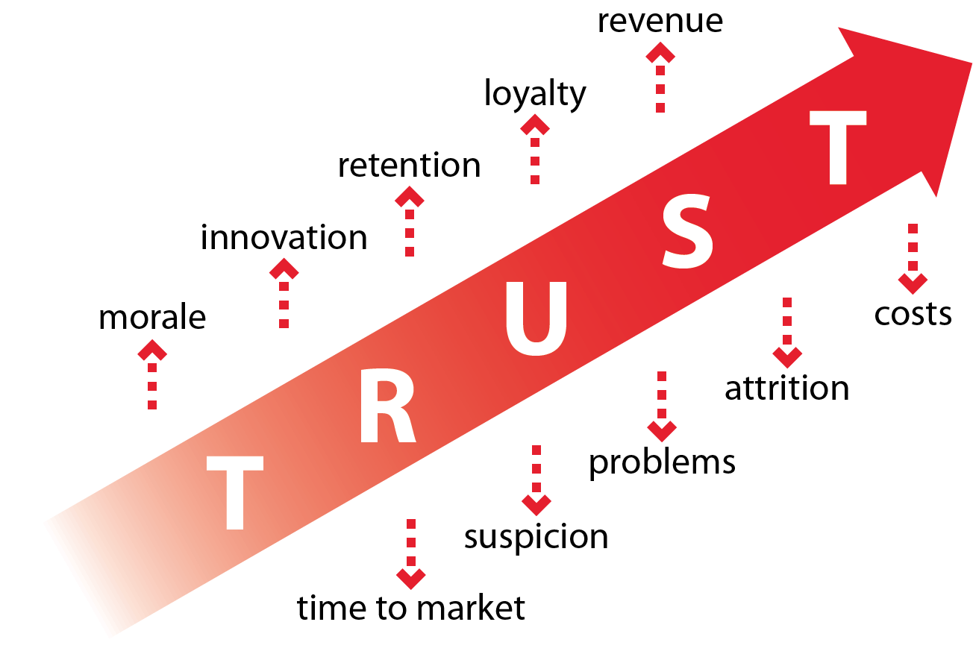
Notes:
This year’s research, from all sorts of perspectives, affirms: investing in Trust is always worth it and the lack of trust is our biggest expense
Which Stat stood out most to you?
Feels most relevant to your organization?

